Slide 1

Demo: Shuffle Features

Slide 2

Agenda
Scope
Live Wendigo Controls
CFA Changes
Caution

Slide 3

Features for discussion
Remove graphics for a content
Shuffle content within a group/widget
Shuffle widgets within a page
Shuffle content graphics
Manage shuffle timer

Slide 4
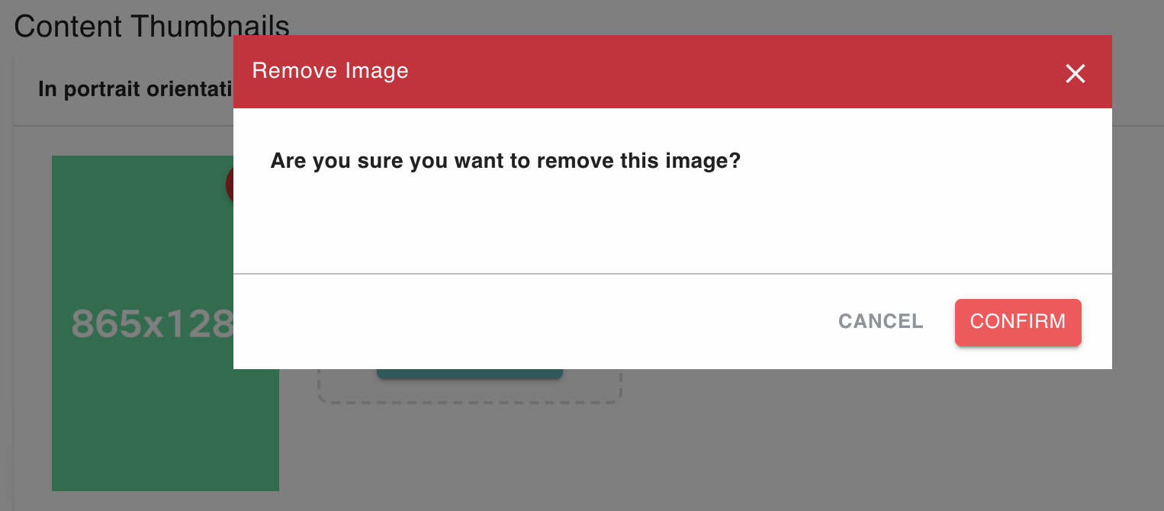
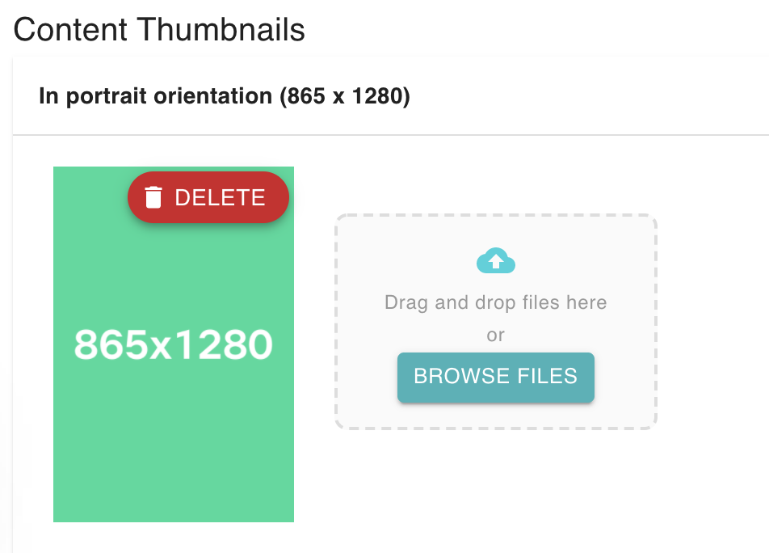
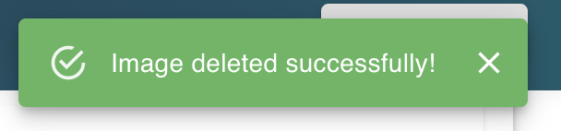
Remove Graphics for a content

Slide 5

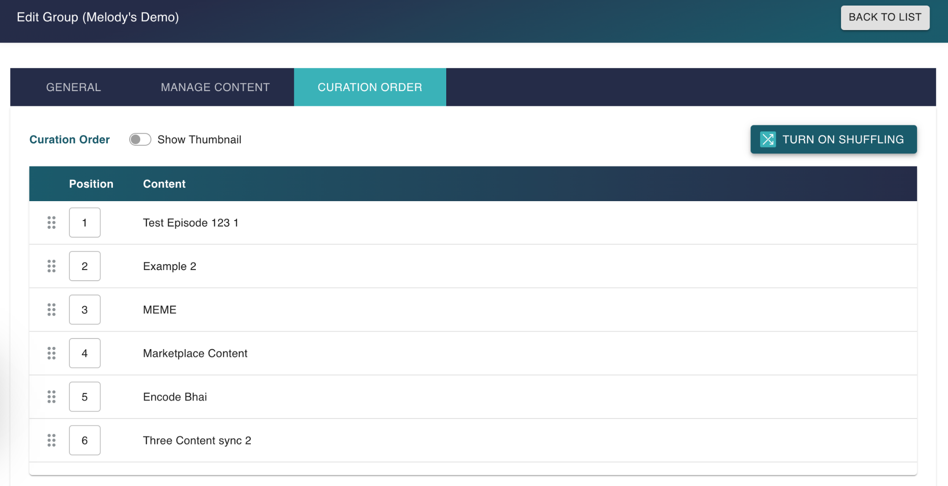
Shuffle content within a group/widget
New feature

Slide 6
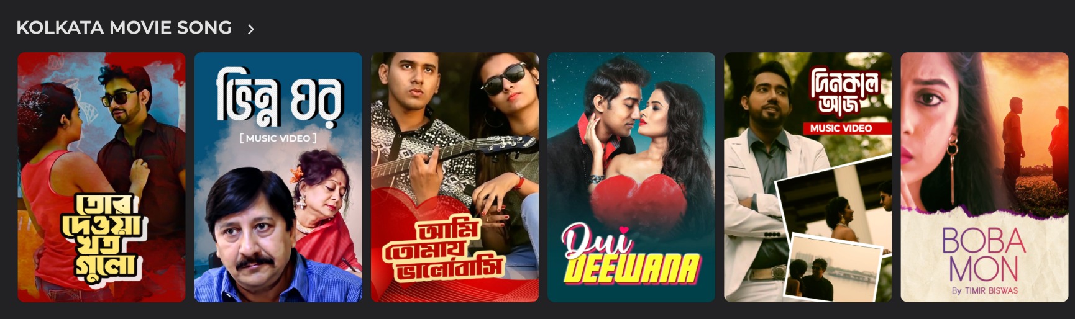

Before Shuffle
After Shuffle

Slide 7
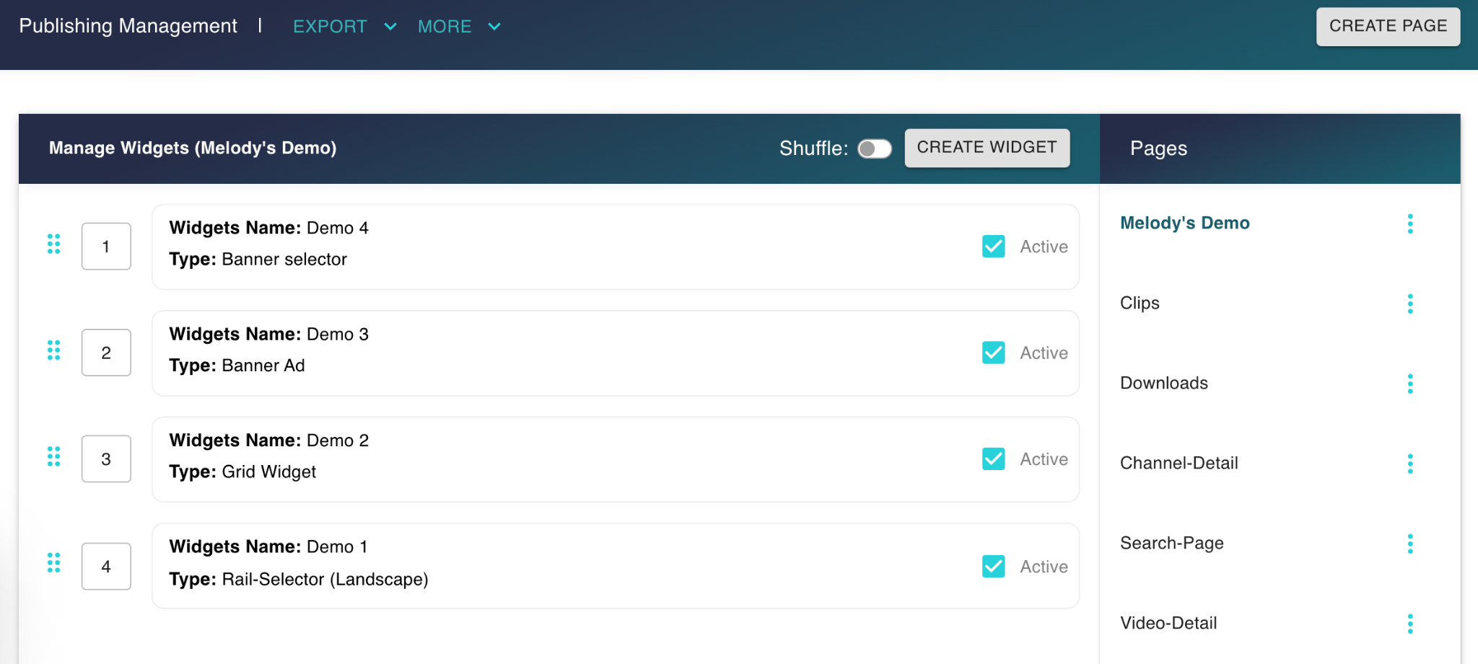
Shuffle widgets within a page
New feature

Slide 8
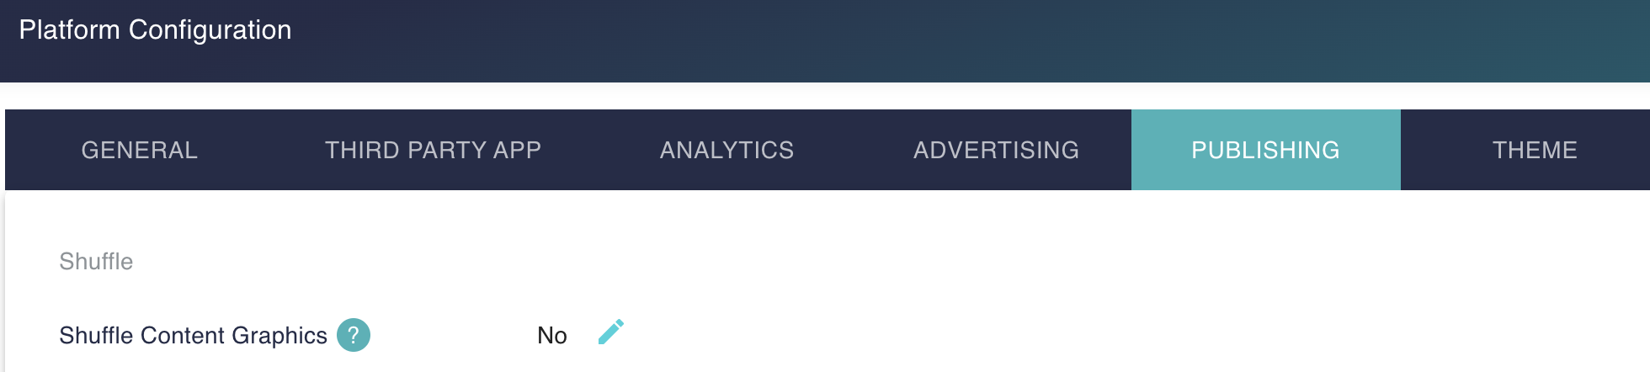
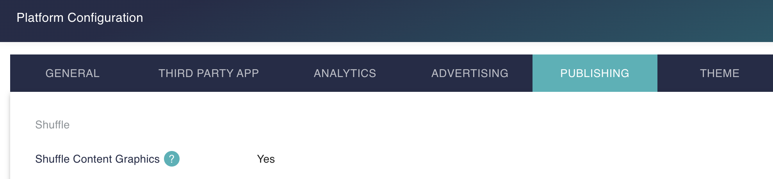
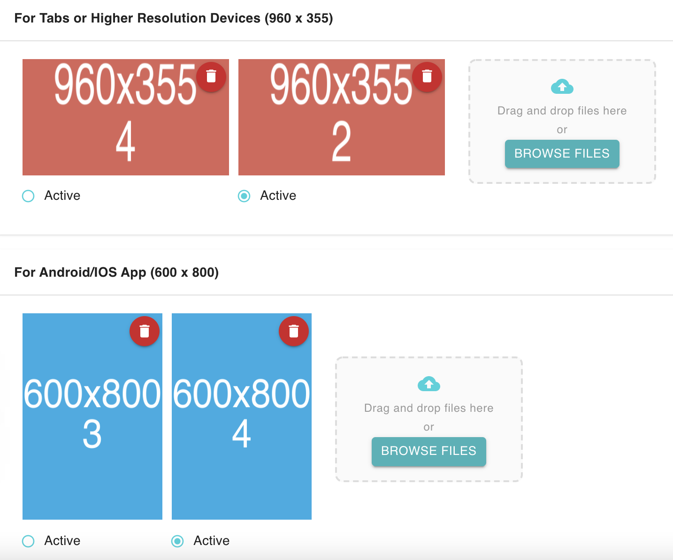
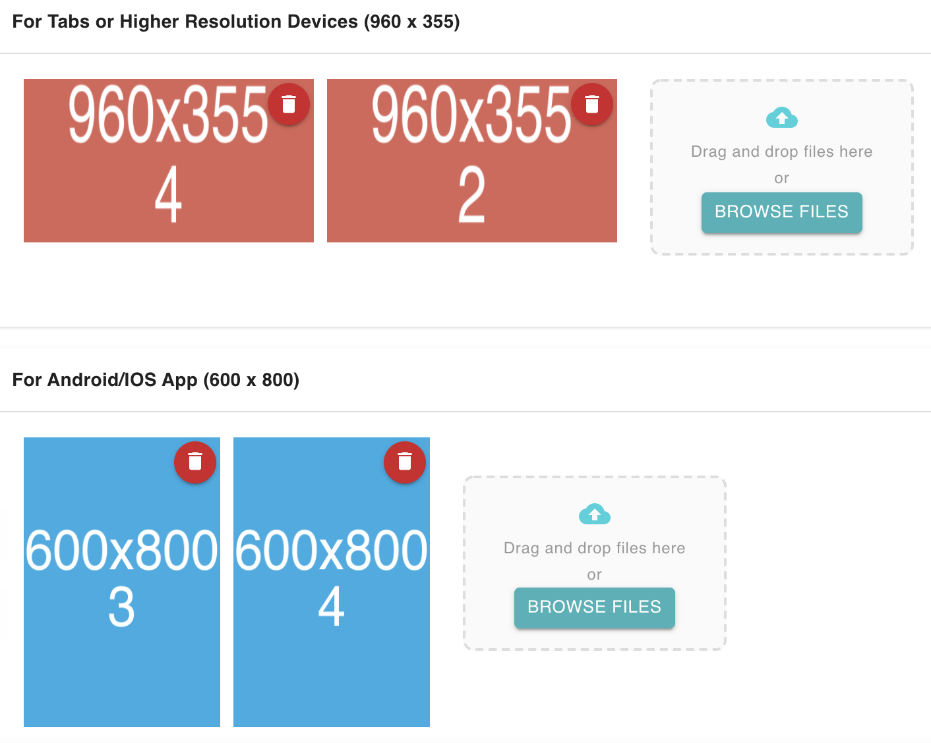
Shuffle content graphics

Slide 9
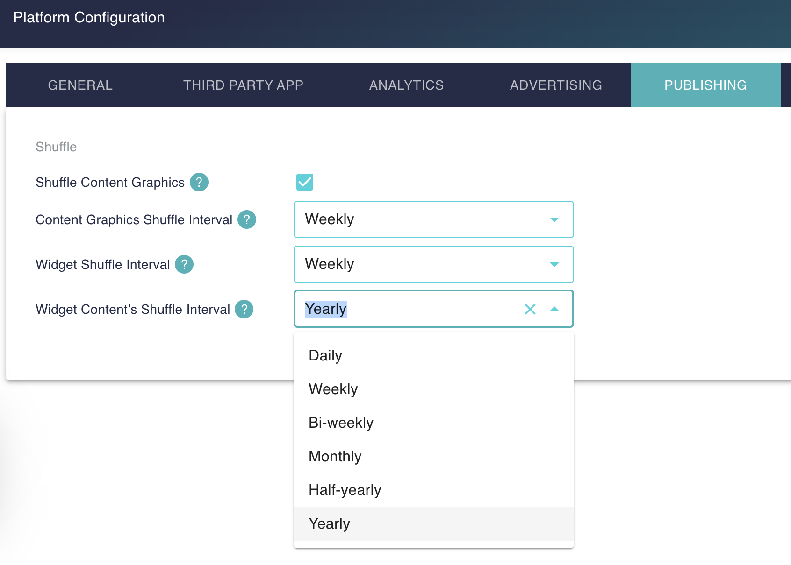
Manage shuffle timer
Timers will be set to Weekly by default

Slide 10
⚠️ Caution
Graphics shuffling is a global setting - when you enable it, the shuffle will be applied to all the graphics of all content. You will not be able to select/unselect any graphic for shuffle. All the graphics will eventually show up on CFA.
To tackle this, before you decide to enable graphics shuffling, you are advised to get rid of all the irrelevant, wrong images from all content
Since now you have delete feature for graphics, it will be easier to control
After you enable any shuffle, it will take effect from next 6AM BDT on the CFA.
There is no revert option for any shuffle. So, we advise that you start with experimenting these shuffle options in a few pages/widgets.

Slide 11
Thank You

